Slide 1

Analyzing Employee Attrition
Team - 1
Sri Lalitha Somaraju
Krishna Priya Vallurupalli
Bindu Sri Kandula
Mounika Nallapraju
Harshini Jampana

Slide 2
Motivation and Objective
Motivation
Given the recent economic downturns, job security and reasons why employees leave have become critical issues. This project aims to uncover what drives employees to leave their jobs
Objectives
Are younger employees more likely to leave than older employees?
What role does work-life balance play in employee attrition?
Are employees in certain departments more likely to leave than in others?
What is the relationship between company size and employee attrition?
Can we predict future employee attrition based on current data?

Slide 3
Contents
Data Overview
Normalization Insights Based on Standard Deviation
Numerical Data Behavior on Attrition
Categorical Factors Impacting Attrition
Correlation Matrix of Numerical Features
Key Variable Coefficients and Impact on Attrition
Decision tree rules
PERFORMANCE SUMMARY TABLE
Recommendations & Conclusion
FEATURE IMPORTANCE

Slide 4

Data Overview
Dataset Source: Kaggle - Employee Attrition Classification Dataset
Dataset Description:59,599 records, 24 columns
Columns: 'Age', 'Gender', 'Years_at_Company', 'Job_Role', 'Monthly_Income', 'Work-Life_Balance', 'Job_Satisfaction', 'Performance_Rating', 'Number_of_Promotions', 'Overtime', 'Distance_from_Home', 'Education_Level', 'Marital_Status', 'Number_of_Dependents', 'Job_Level', 'Company_Size', 'Remote_Work', 'Leadership_Opportunities', 'Innovation_Opportunities', 'Company_Reputation', 'Employee_Recognition', 'Attrition'

Slide 5
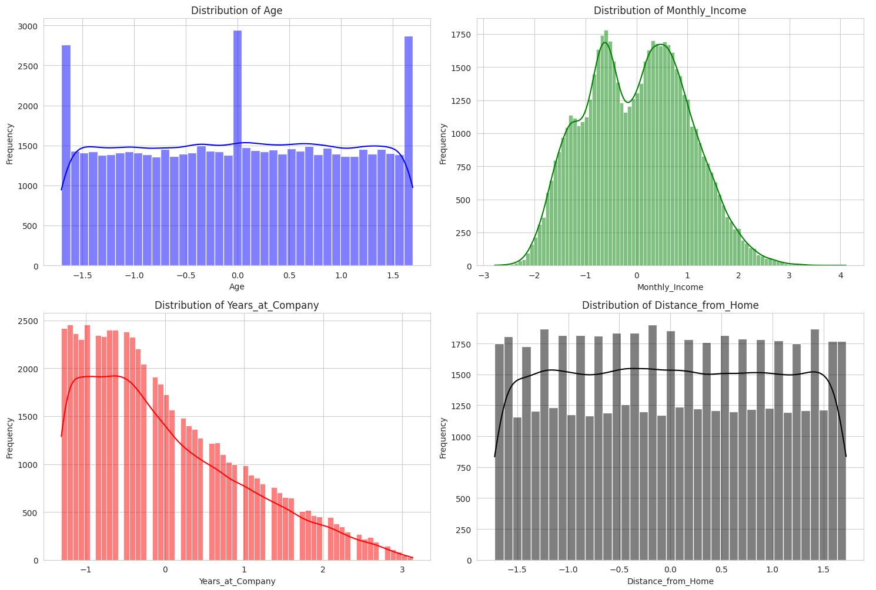
Normalization Insights Based on Standard Deviation
High Standard Deviations:
Monthly Income (2151.46) and Distance from Home (28.47) have high variability compared to their means.
Normalization will help standardize these features for better model performance.
Years at Company (11.25):
Despite its skewness and smaller range (1–51), normalization ensures consistent scaling, reducing the impact of outliers.
Age (12.08):
Moderate deviation around the mean suggests normalization can help balance this feature relative to others with larger spreads.

Slide 6
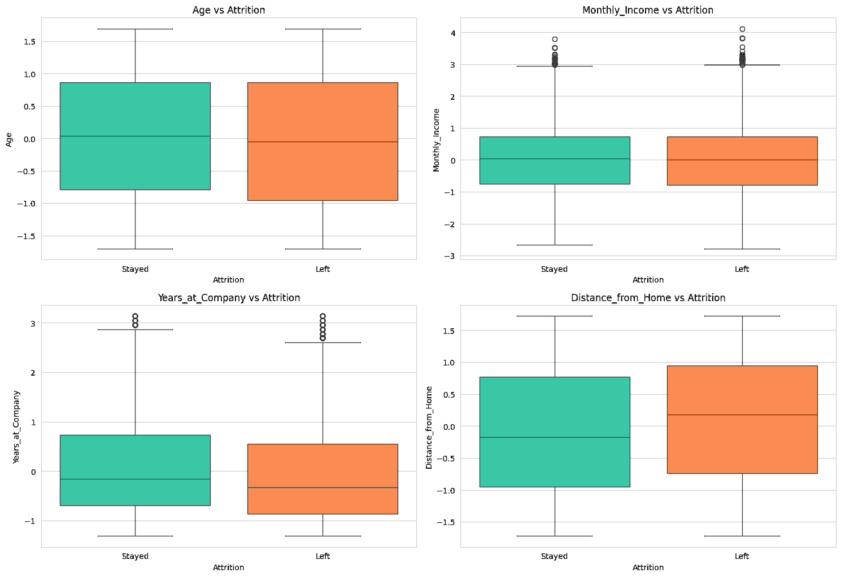
Numerical Data Behavior on Attrition
Age vs Attrition:
Older employees are more likely to stay, as the median age of those who stayed is higher than those who left.
Monthly Income vs Attrition:
Employees with lower monthly incomes are more likely to leave, indicated by the lower median income for those who left.
Years at Company vs Attrition:
Employees with longer tenures are less likely to leave, as shown by the higher median years at the company for those who stayed.
Distance from Home vs Attrition:
Distance from home shows no significant impact on attrition, with similar medians for both groups.

Slide 7
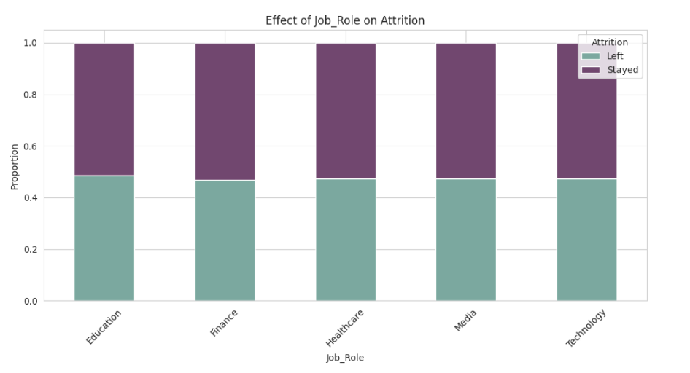
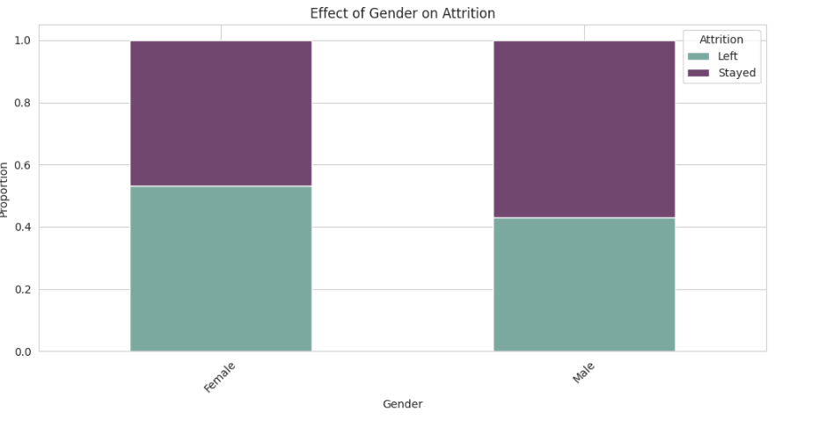
Categorical Factors Impacting Attrition
Gender:
Both genders show similar attrition trends; differences are less impactful when considering absolute numbers.
Job Role:
High-stress roles like Media and Finance have greater attrition, while roles like Education and Health show better retention.

Slide 8
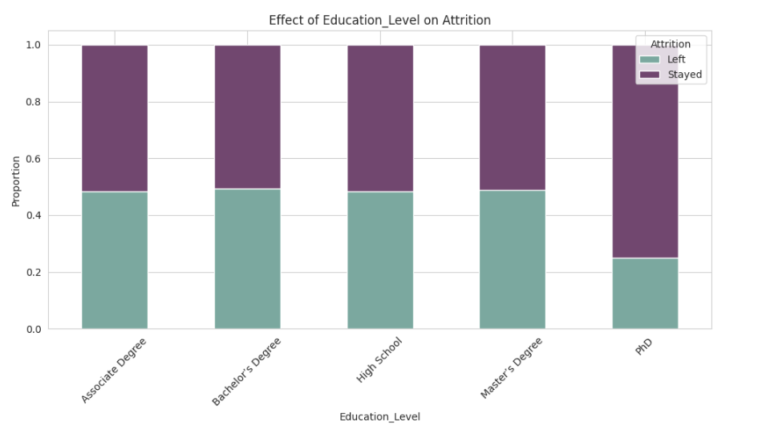
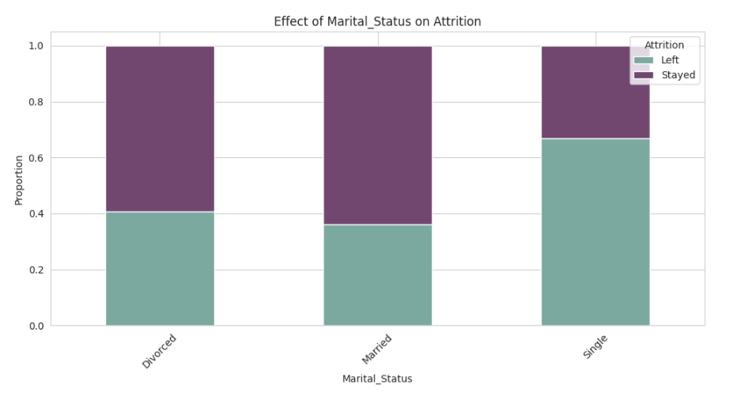
Categorical Factors Impacting Attrition
Marital Status:
Single employees have higher attrition rates compared to married or divorced employees.
Education Level:
Higher attrition in High School and Bachelor's Degree categories; PhDs show much lower attrition but are fewer in number.

Slide 9
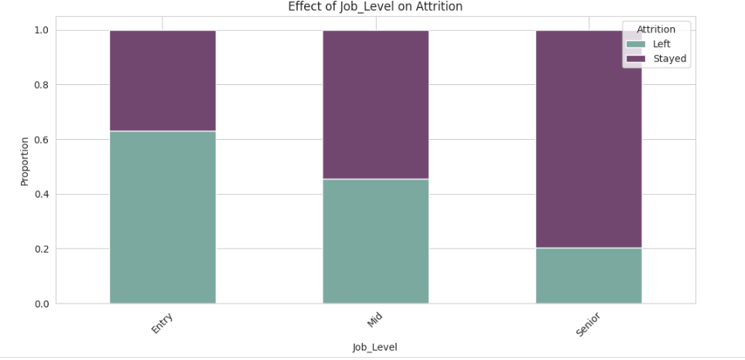
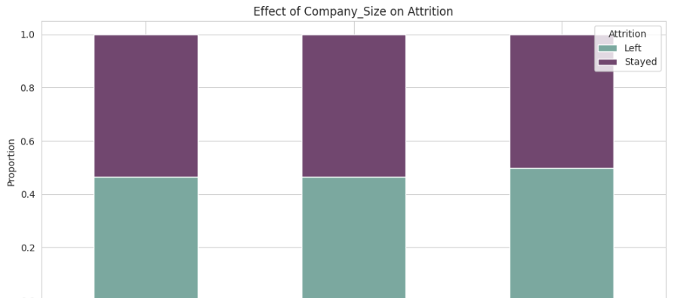
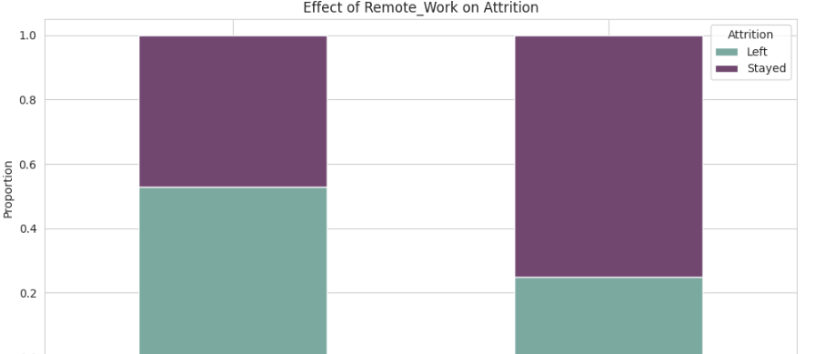
Categorical Factors Impacting Attrition
Job Level:
Entry-level positions show the highest attrition; retention improves as employees advance in job levels.
Company Size:
Small companies experience higher attrition due to fewer opportunities, while larger companies show better retention.
Remote Work:
Remote work significantly reduces attrition, highlighting its importance for employee satisfaction.

Slide 10
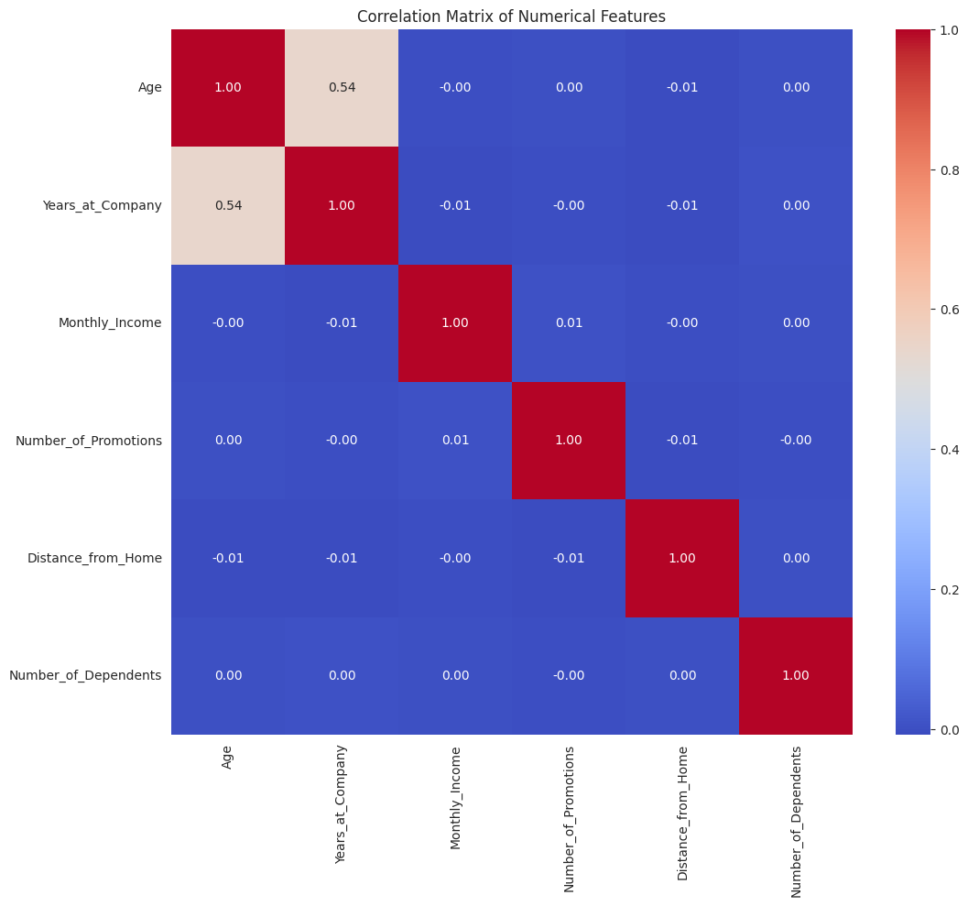
Correlation Matrix of Numerical Features
Age and Years at Company:
Moderate positive correlation (0.54), indicating that older employees tend to have longer tenures.
Monthly Income, Promotions, Distance from Home, and Dependents:
Show very little to no correlation with each other.
Conclusion:
These variables are largely independent, suggesting their effects on attrition are distinct and non-overlapping.

Slide 11
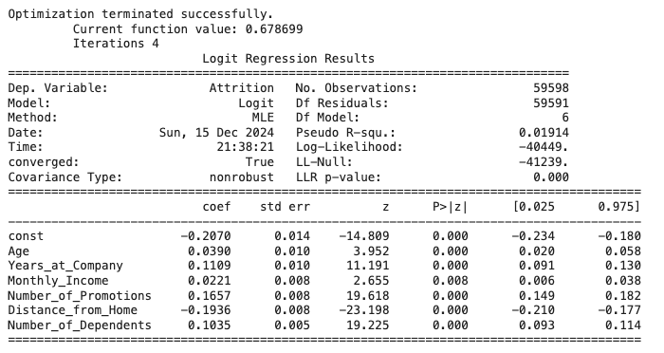
Key Variable Coefficients and Impact on Attrition
Age (0.039):
Older employees are slightly more likely to stay; each additional year reduces attrition likelihood slightly.
Years at Company (0.1109):
Longer tenure significantly reduces attrition, reflecting employee loyalty over time.
Monthly Income (0.0221):
Higher income increases retention, though the effect is mild.
Number of Promotions (0.1657):
More promotions strongly decrease attrition, highlighting the importance of career growth.
Distance from Home (-0.1936):
Longer commutes increase the likelihood of leaving, showing a strong negative impact.
Number of Dependents (0.1035):
Employees with more dependents are slightly more likely to stay, prioritizing job stability.

Slide 12
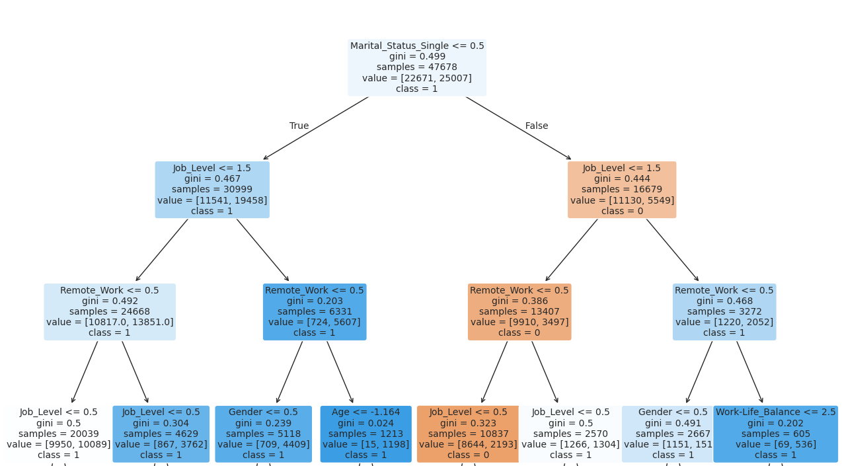
Decision tree rules
Rules
Job Level and Remote Work Influence
Condition: Job Level ≤ 1.5 and Remote Work ≤ 0.5. --class = 1
Value: [10817.0, 136851.0]
Marital Status and Remote Work Influence
Condition: Marital_Status_Single ≤ 0.5, Job Level > 1.5, and Remote Work ≤ 0.5.--class = 0
Value: [9910, 3497]
Age and Job Level Influence
Condition: Job Level ≤ 1.5, Marital_Status_Single = 1, and Age ≤ -1.164.-- class = 1
Value: [15, 1198]
Work-Life Balance Influence
Condition: Marital_Status_Single ≤ 0.5, Job Level > 1.5, and Work-Life_Balance > 2.5. class = 1
Value: [69, 536]
Gender and Job Level Influence
Condition: Job Level ≤ 0.5 and Gender ≤ 0.5 (Female). class = 1
Value: [709, 4409]

Slide 13

Key Points on Predicting Employee Attrition
Cost Savings: Predicting attrition helps reduce the financial and productivity losses associated with replacing employees.
Retention of Expertise: Enables companies to retain key employees with unique skills or critical roles by addressing their concerns.
Improved Team Morale: Proactive measures can prevent morale issues and mitigate the ripple effect of employee departures.
Strategic Workforce Planning: Helps HR maintain the right skill balance and plan recruitment effectively to avoid disruptions.

Slide 14
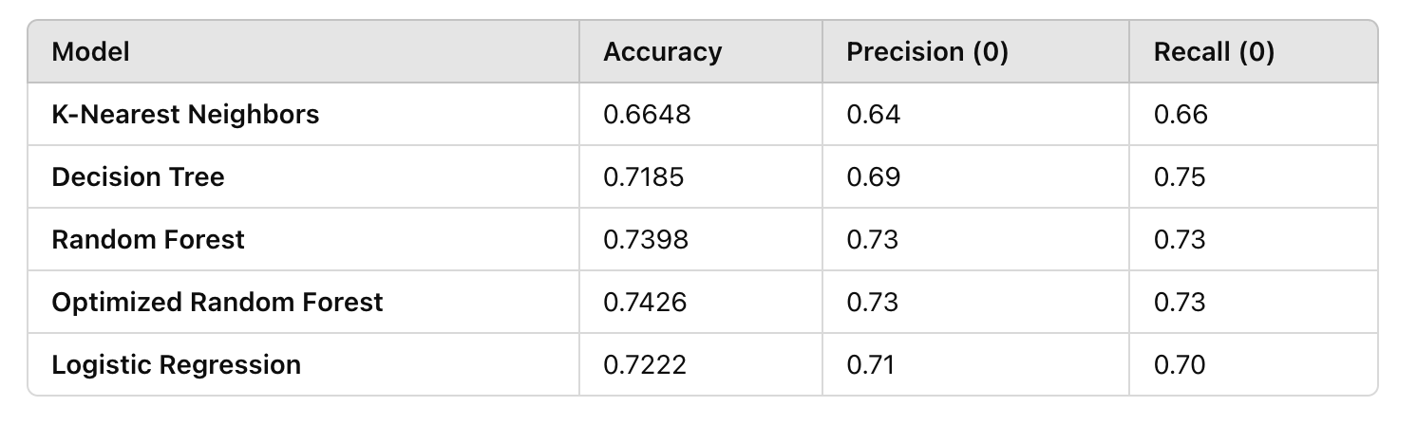
PERFORMANCE SUMMARY TABLE

Slide 15
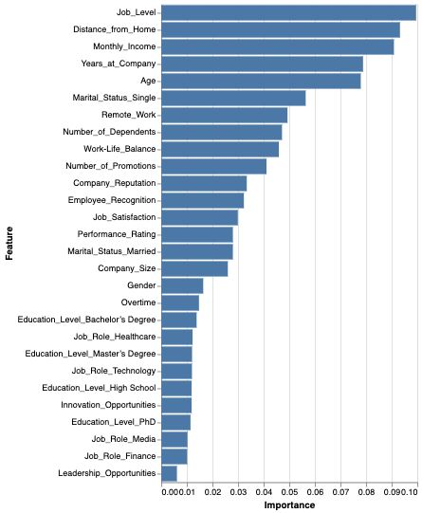
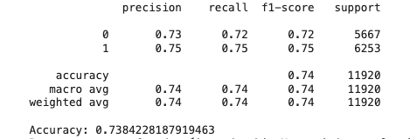
FEATURE IMPORTANCE BREAKDOWN
Job Level:
Most important factor.
Higher job positions decrease the likelihood of leaving.
Distance from Home:
Longer commutes increase the likelihood of leaving.
Shorter commutes strongly influence retention.
Monthly Income:
Higher salaries reduce attrition.
Salary is a crucial factor for employee retention.
Years at the Company & Age:
Longer tenure reduces attrition.
Older employees are more likely to stay, indicating loyalty and job satisfaction.
Marital Status:
Single employees are more likely to leave.
Married employees are more likely to stay due to family commitments.
Remote Work:
Ability to work remotely decreases attrition.
Flexibility in work location is key for retention.
Number of Dependents & Work-Life Balance:
Employees with dependents are more likely to stay.
Better work-life balance encourages retention.
Support for personal commitments reduces attrition.
Key Takeaways
Job Level is the top factor influencing retention.
Commute Distance, Income, and Flexibility are critical for employee satisfaction.
Personal Factors: Marital status, dependents, and work-life balance play significant roles.
Loyalty Indicators: Tenure and age are strong predictors of retention.

Slide 16
Recommendations & Conclusion
Recommendations from model
Optimized Random Forest Model:
Stands out as the best choice among all models.
Highest Accuracy: 74.28%, indicating it makes correct predictions more often.
High Recall for 'Leave' (0): 0.73 (tied with standard Random Forest), which is critical for identifying employees at risk of leaving.
High recall ensures most at-risk employees are identified, enabling timely HR interventions.
Strong Precision: Ensures that when the model predicts an employee will leave, it is likely correct.
Helps HR teams efficiently target retention efforts.
Conclusion
Predicting employee attrition is essential due to the high costs and disruptions associated with replacing key staff.
The Optimized Random Forest model:
Provides the best balance of accuracy, recall, and precision.
Offers customizable settings for further optimization.
Enables employers to proactively identify and retain at-risk employees.
Implementing this model can significantly reduce turnover rates and the associated costs.

Slide 17

Thank you

